Slide 1
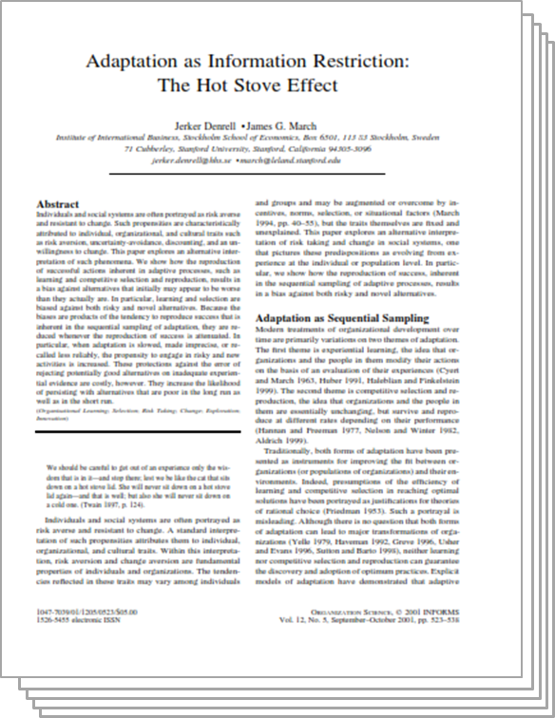
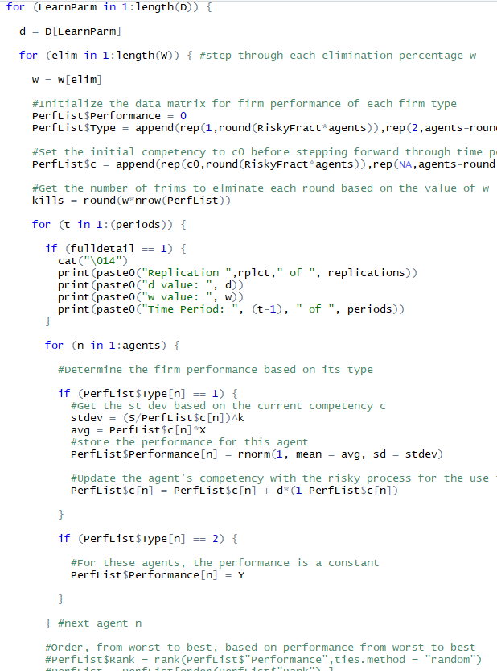
Replicating a Model:
Adaptation as Information Restriction: The Hot Stove Effect
By Jerker Denrell and James G. March
Presented by James Paine
February 22, 2019

Slide 2
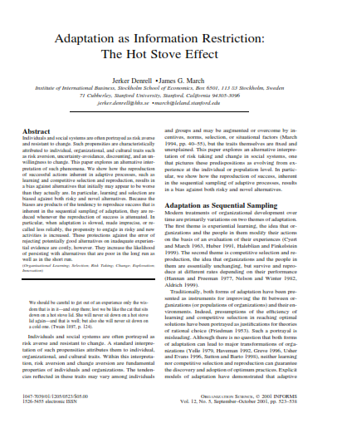
Paper Background
Published in Organization Science in 2001
“Hot Stove” effect can be summarized as the over-correction (or basis) away from risky behavior due to early negative experiences
Modeling is based on individual/firm choosing one of two alternatives
One with ‘certain’ outcomes
Another with ‘risky’ (normally distributed) outcomes
‘Aspiration level’ as benchmark of outcomes for agent-level simulations
Relative performance with thresholding as benchmark for multi-agent (or multi-firm) simulations
‘Competence’ as mechanism for experiential learning improvements

Slide 3

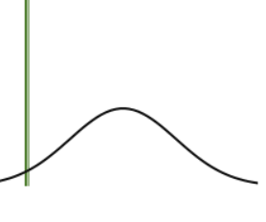

Model Details
Experiential Learning
5,000 simulated individuals draw from either a ‘certain’ or ‘risky’ (normally distributed) payout
Payout histories are recorded as the ‘aspiration level’
IF the payout exceeds the aspiration level, the probability of choosing that choice increases linearly as a function of a parameter ‘a’
Explores the number of individuals still making ‘risky’ choices after 50 time steps as a function of the linear parameter a
Competitive Selection
100 simulated firms are categorized as always either drawing from the risky or certain payouts
Overall performance is assed after each period, with some fraction w of the worst performers being replaced
New firm are populated each round proportionally (or randomly)
Explores the number of firms of the risky type still surviving at the end of 50 rounds as a function of the parameter w
?
?

Slide 4
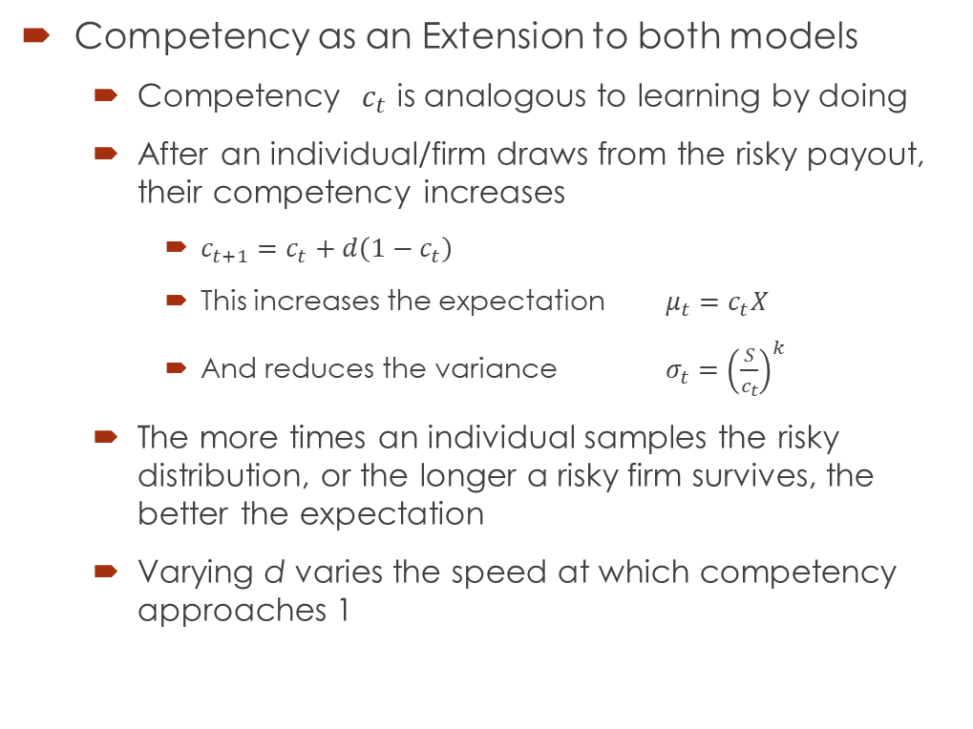
Model Details
Competency as an Extension to both models
Competency $c_{t}$ is analogous to learning by doing
After an individual/firm draws from the risky payout, their competency increases
$c_{t+1}=c_{t}+d\left(1−c_{t}\right)$
This increases the expectation $μ_{t}=c_{t}X$
And reduces the variance $σ_{t}={\left(\frac{S}{c_{t}}\right)}^{k}$
The more times an individual samples the risky distribution, or the longer a risky firm survives, the better the expectation
Varying d varies the speed at which competency approaches 1

Slide 5
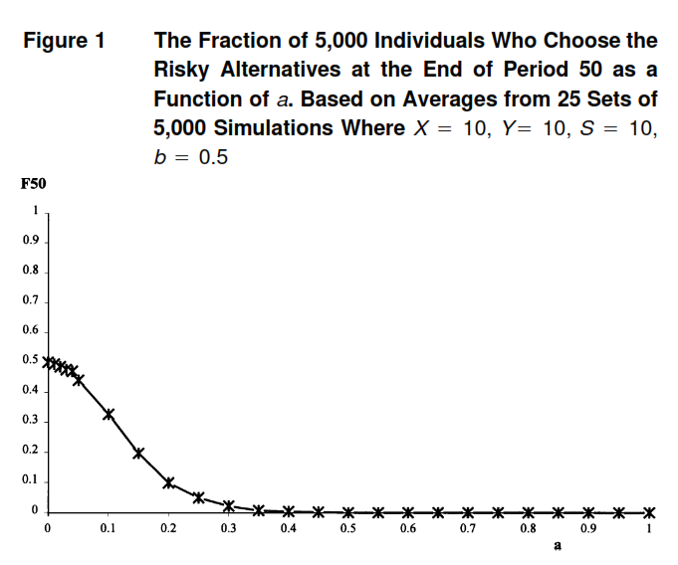
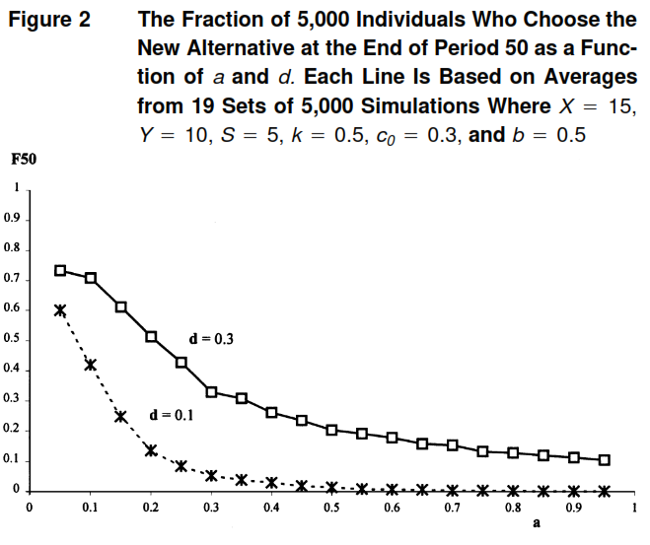
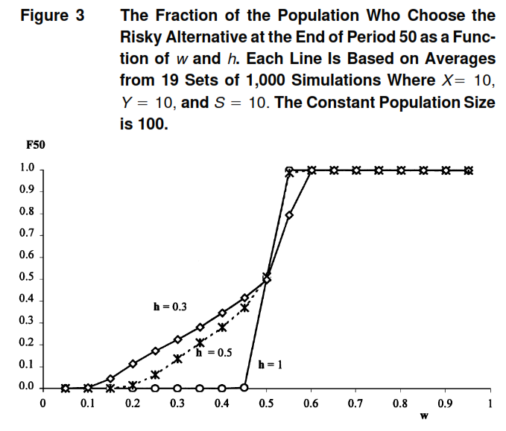
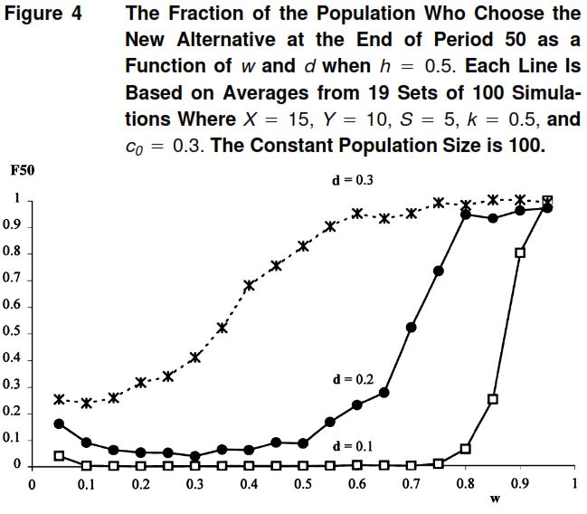
Model Details
 | Without Competency Mechanism | With Competency Mechanism
Experiential
Competitive Selection

Slide 6
Replication
Recreated the 4 model variations
R as the programming language
Two structural methods used:
Experiential: Array based memory allocation (full history retained)
Competitive: Data Frame based memory allocation (history overwritten)
Code written to be flexible to explore full parameter spaces
Additional mechanisms and triggers incorporated
Competitive: cumulative performance and inter-generational competency transfer
Matched the model terminology and structure from Denrell and March
For all but one, used the published parameter values and visually compared my results to Denrell and March

Slide 7
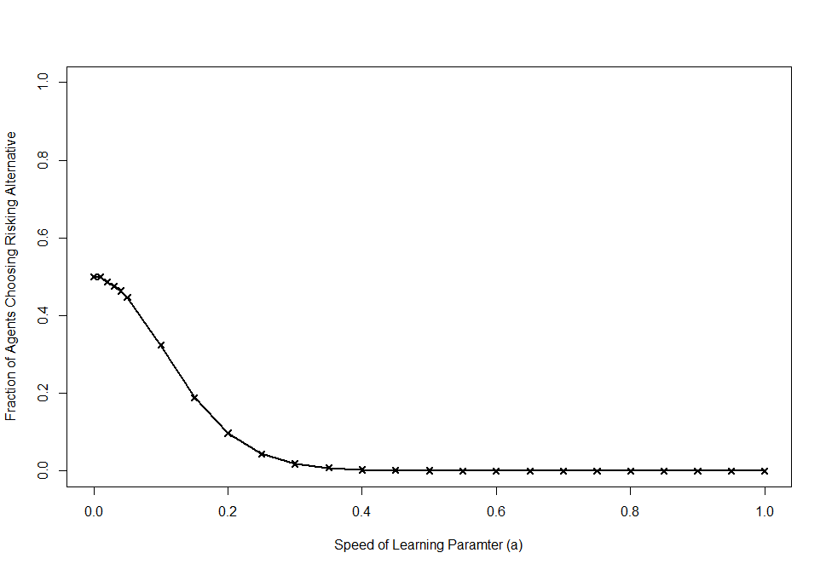
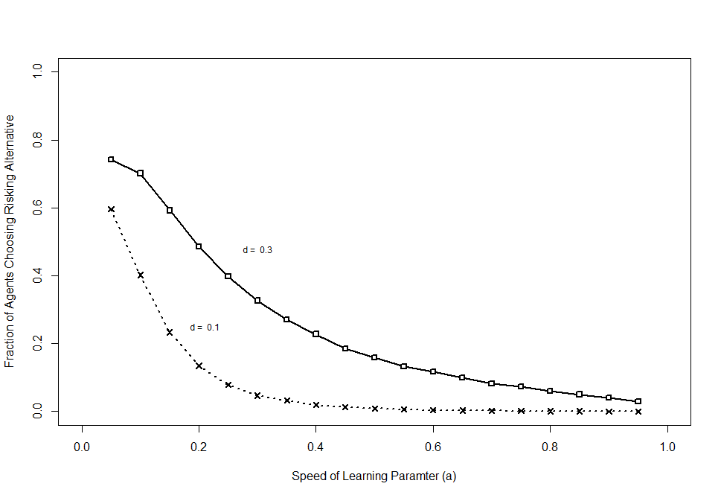
Experiential Model Recreations – Directional Results
Paper Outputs
Paper Outputs
Replication outputs
Replication outputs

Slide 8
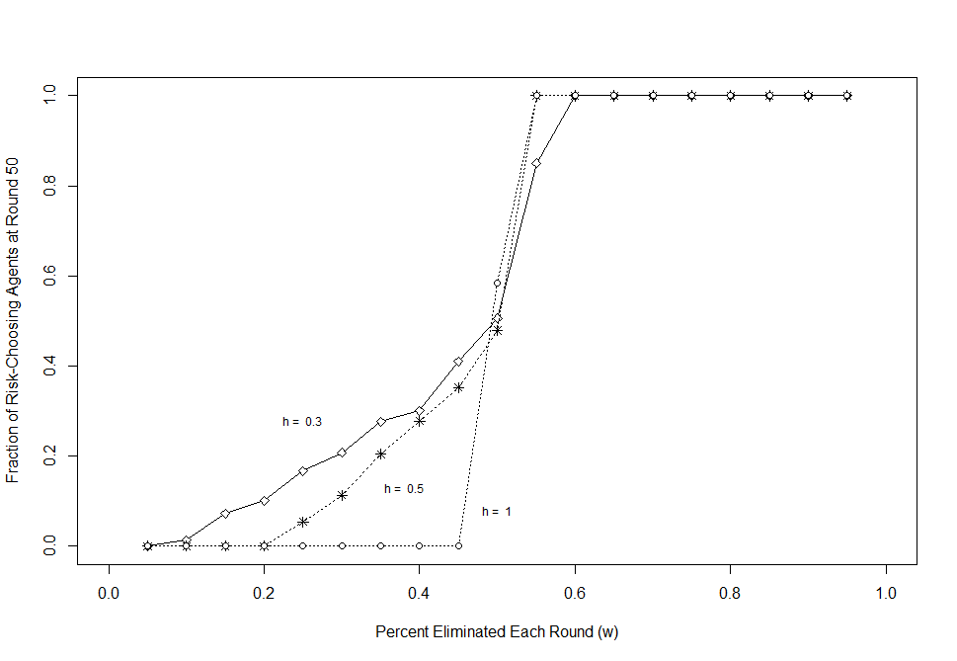
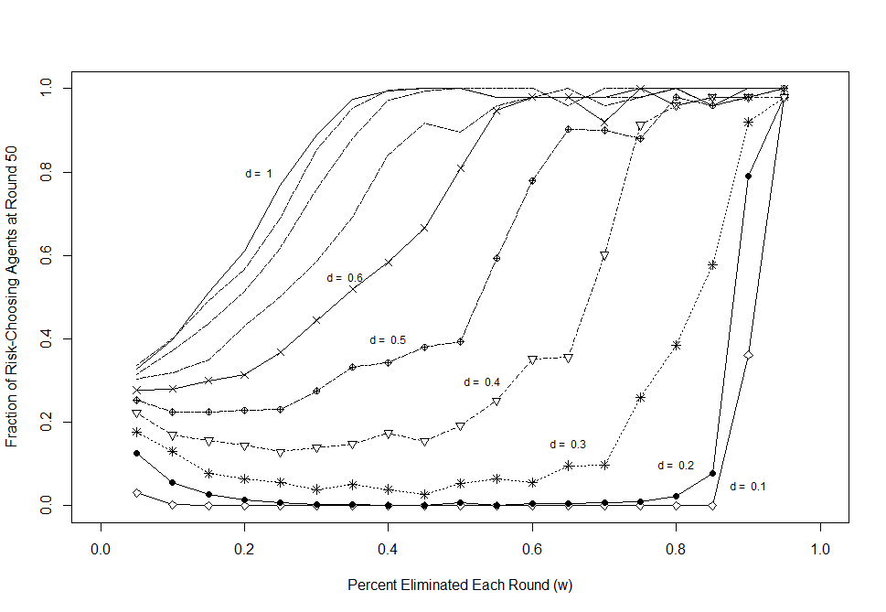
Competitive Selection Model Recreations – Directional Results
Paper Outputs
Paper Outputs
Replication outputs*
Replication outputs

Slide 9
R Script Demos
 | Without Competency Mechanism | With Competency Mechanism
Experiential
Competitive Selection

Slide 10
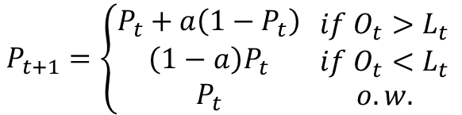

Critiques on Model Formulation
Exact number of replications of the model is obfuscated, and only implied from the graph descriptions
For the experiential learning models, the 5000 agents are implied to be run only once
For the Competitive Selection models, the first model is implied to be repeated 10 times while the second appears to have been run only once
In experiential learning, the aspirations are one-sided and probability updates are linear
Aspirations are relative to choice 1 only (not immediately clear in the paper)
Changes to probability are only if aspiration is exceed/missed, and then change by a constant factor no matter the distance of the realization from the aspiration
Not immediately clear on how to extend to >2 choices
$$L_{t+1}=L_{t}\left(1−b\right)+O_{t}b$$
$$P_{t+1}=\left\{\begin{matrix}P_{t}+a\left(1−P_{t}\right) \\ \left(1−a\right)P_{t} \\ P_{t}\end{matrix} \begin{matrix}if O_{t}>L_{t} \\ if O_{t}<L_{t} \\ o.w.\end{matrix} \right.$$

Slide 11
Critiques on Paper Reproducibility
Figure 4 (Competitive Selection with competency learning) was difficult to reproduce
Authors appear to only have run the model once
Full envelop of survivability as a function of w and d missing from the paper
When looking at the full envelop, my model appears to be off by a factor of two w.r.t. d values
Have recreated the model multiple times from scratch, and still have the same discrepancy
However when looking at the full envelop in my simulation, the directional results hold

Slide 12
Extensions and Suggestions
Create more generalized envelopes of parameter interactions
Vary at least over all parameters mentioned in the model
The authors do not vary over b and only talk about varying over k
Show all results, specifically learning transference in the competitive survival models
Make competitive survival more realistic
Start with low number of risky firms
Perhaps use beta distribution to reflect more realistic starting state for new risky process
Evaluate based on cumulative performance, not period-by-period
Explore dynamics of the system in the time periods before t=50

Slide 13
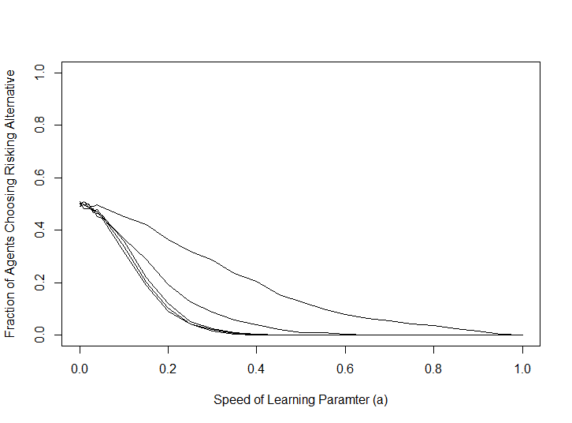
Extensions and Suggestions
Varying over additional parameters, like b as seen below, yields additional behavior
b static at b=0.5
b = 1
b = 0.999
b = 0.5
b = 0.95
Increasing b (rate at which aspiration incorporates new information) yields threshold near 1 at which ‘Risky’ agent suddenly becomes much more prevalent in the system

Slide 14
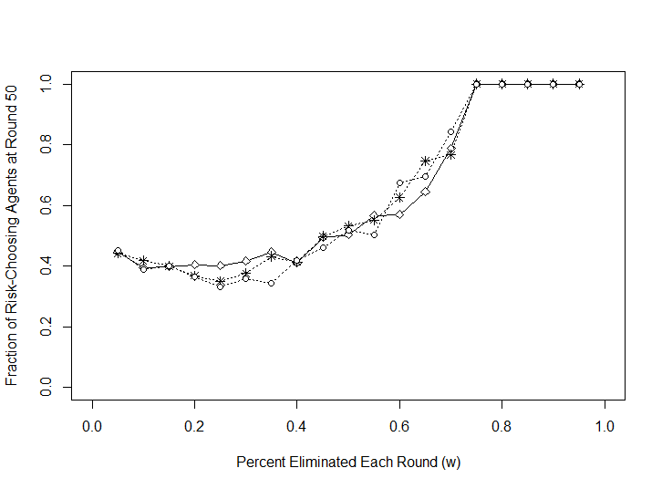
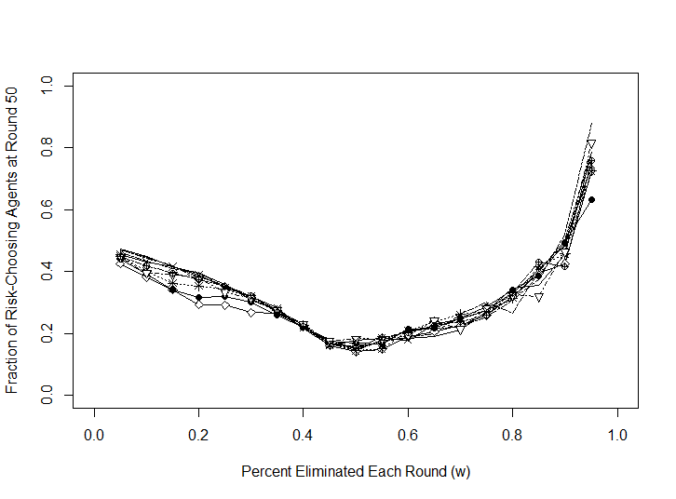
Extensions and Suggestions
Evaluate cumulative survival based on cumulative performance
Without Competency Building
With Competency Building
Period-By-Period
Period-By-Period
Cumulative
Cumulative
d and h matter less in aggregate when performance is cumulative, and the behavior is more generalizable

